Slide 1

Optimizing Your Travel Experience
Flight Delay & Cancellation Predictive Model
Team Gordon

Slide 2
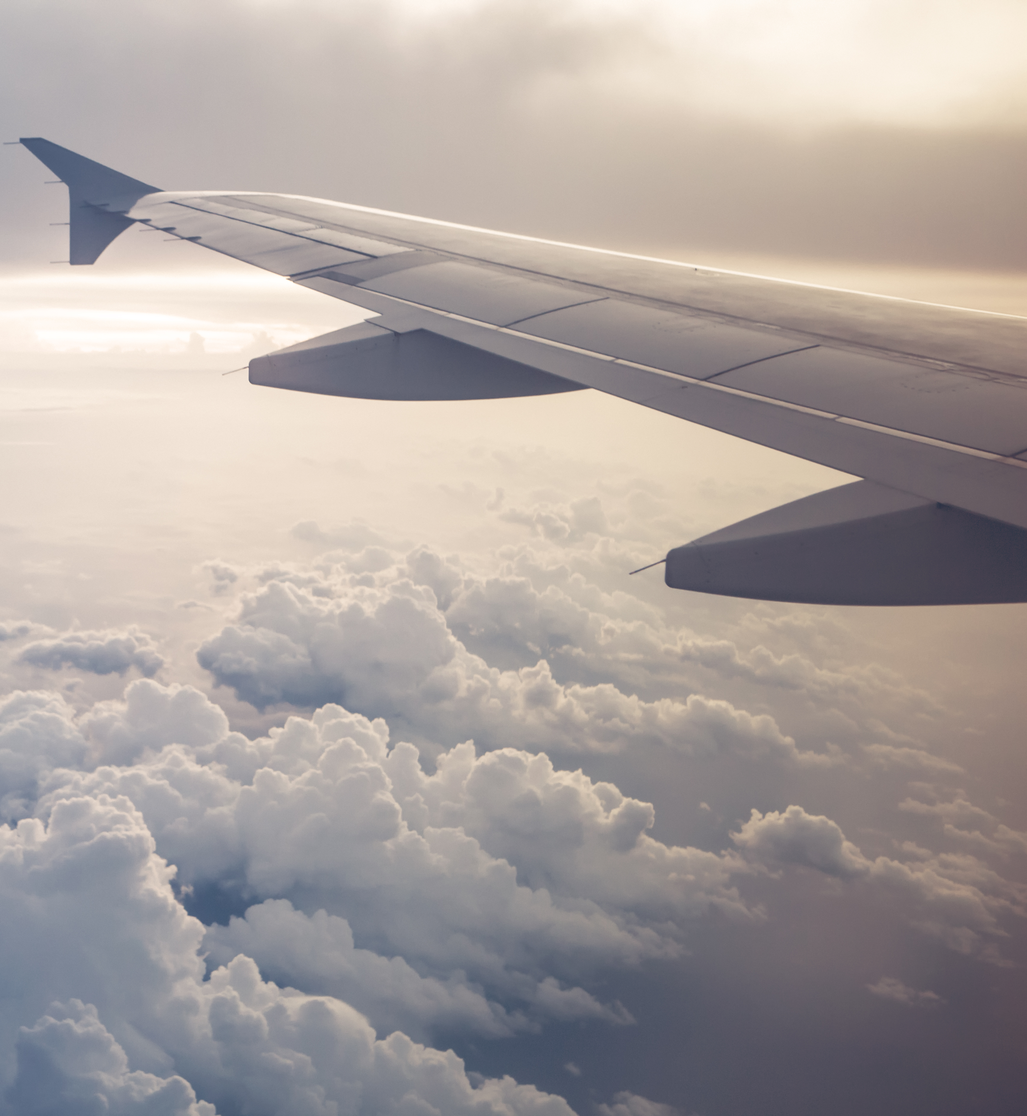
We are Gordon Travel
Special Program for our Loyal Customers
Help them to choose good flights that have less possibilities of delay/cancel
Looking for cooperate with an airline for winter promotion

Slide 3

Our dataset
Date of the flight, Airline, City of origin airport, Scheduled/Actual departure time, Departure delay, Time spent taxiing out, Scheduled/Actual arrival time, Arrival delay, Cancelled(1 for cancelled, 0 for not cancelled), Reason for cancellation, DISTANCE, DELAY_DUE_CARRIER, DELAY_DUE_WEATHER, DELAY_DUE_NAS, DELAY_DUE_SECURITY, DELAY_DUE_LATE_AIRCRAFT
Key Columns
Flight Data within U.S (2019-2023)

Slide 4
FLIGHT delays

Slide 5
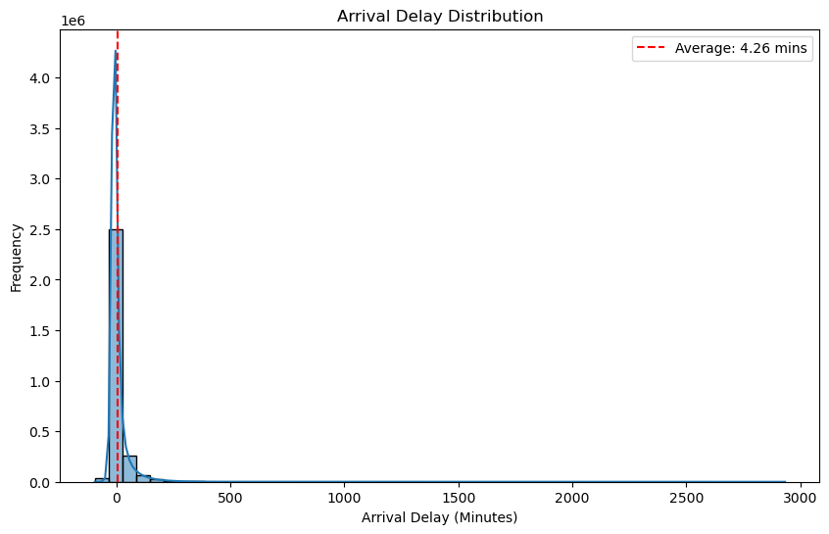
How many flights experience Arrival Delays?
Percentage of flights with arrival delays: 33.57%
Average Arrival Delay: 4.26 minutes
Range of Arrival Delays: -96.0 minutes to 2934.0 minutes

Slide 6
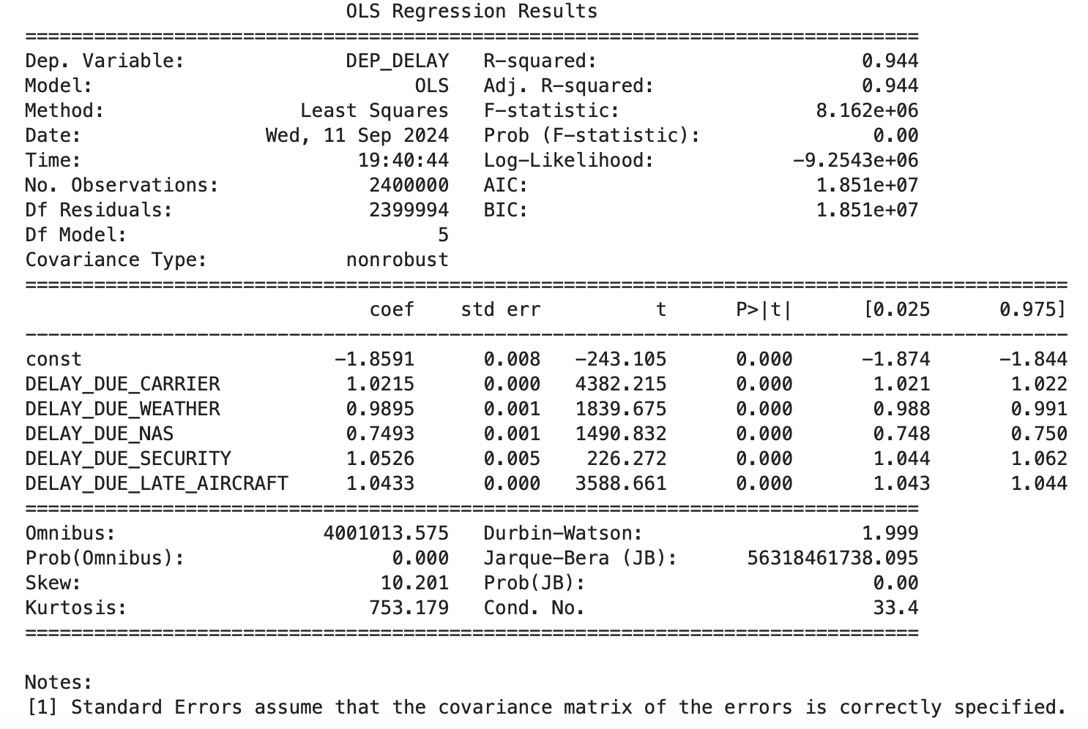
Causes of Delayed Flights
Linear regression model
Top causes of delay:
Security
Late aircraft arrival
Carrier
Relatively high R-squared

Slide 7
How should we choose flights for customers?
Month & Date
Airport
Airline

Slide 8

Delay Prediction Model
Logistic Regression
Input: Airlines, Airports, day of the week, month, distance, scheduled departure/arrival time
Predict if flight will be delayed(Assume arrival delay > 10 minutes as delayed)

Slide 9
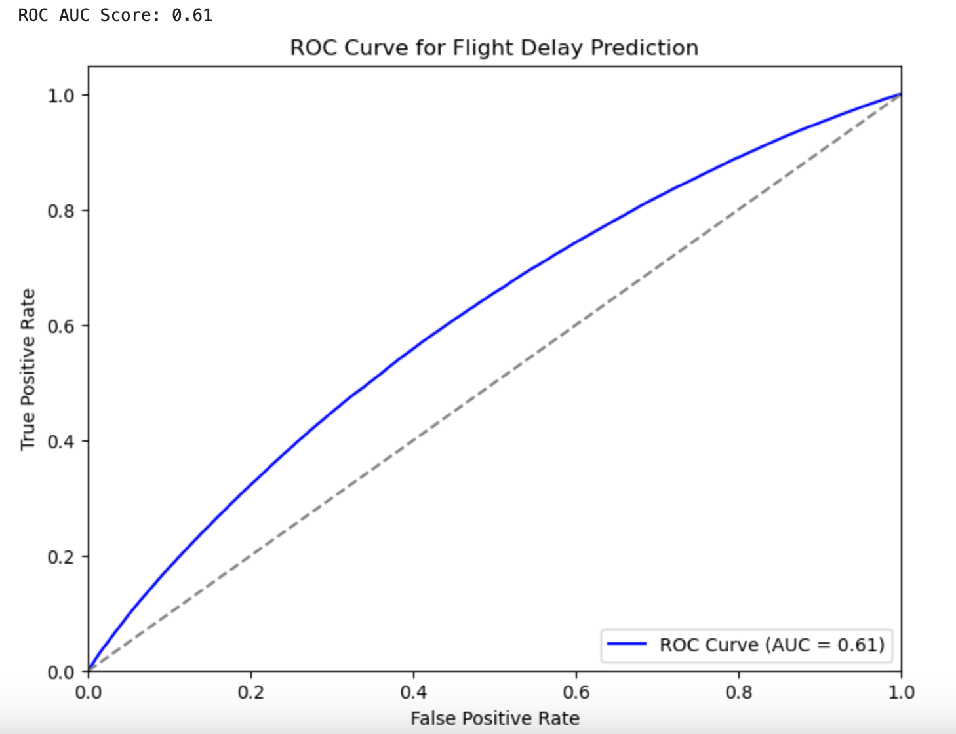
Delay Prediction Model Evaluation
Accuracy 0.79, AUC 0.61
The model has some predictive power but not very high
Limited data before booking tickets(cannot predict weather/NAS)
Could be used to predict future flights' delay probability

Slide 10
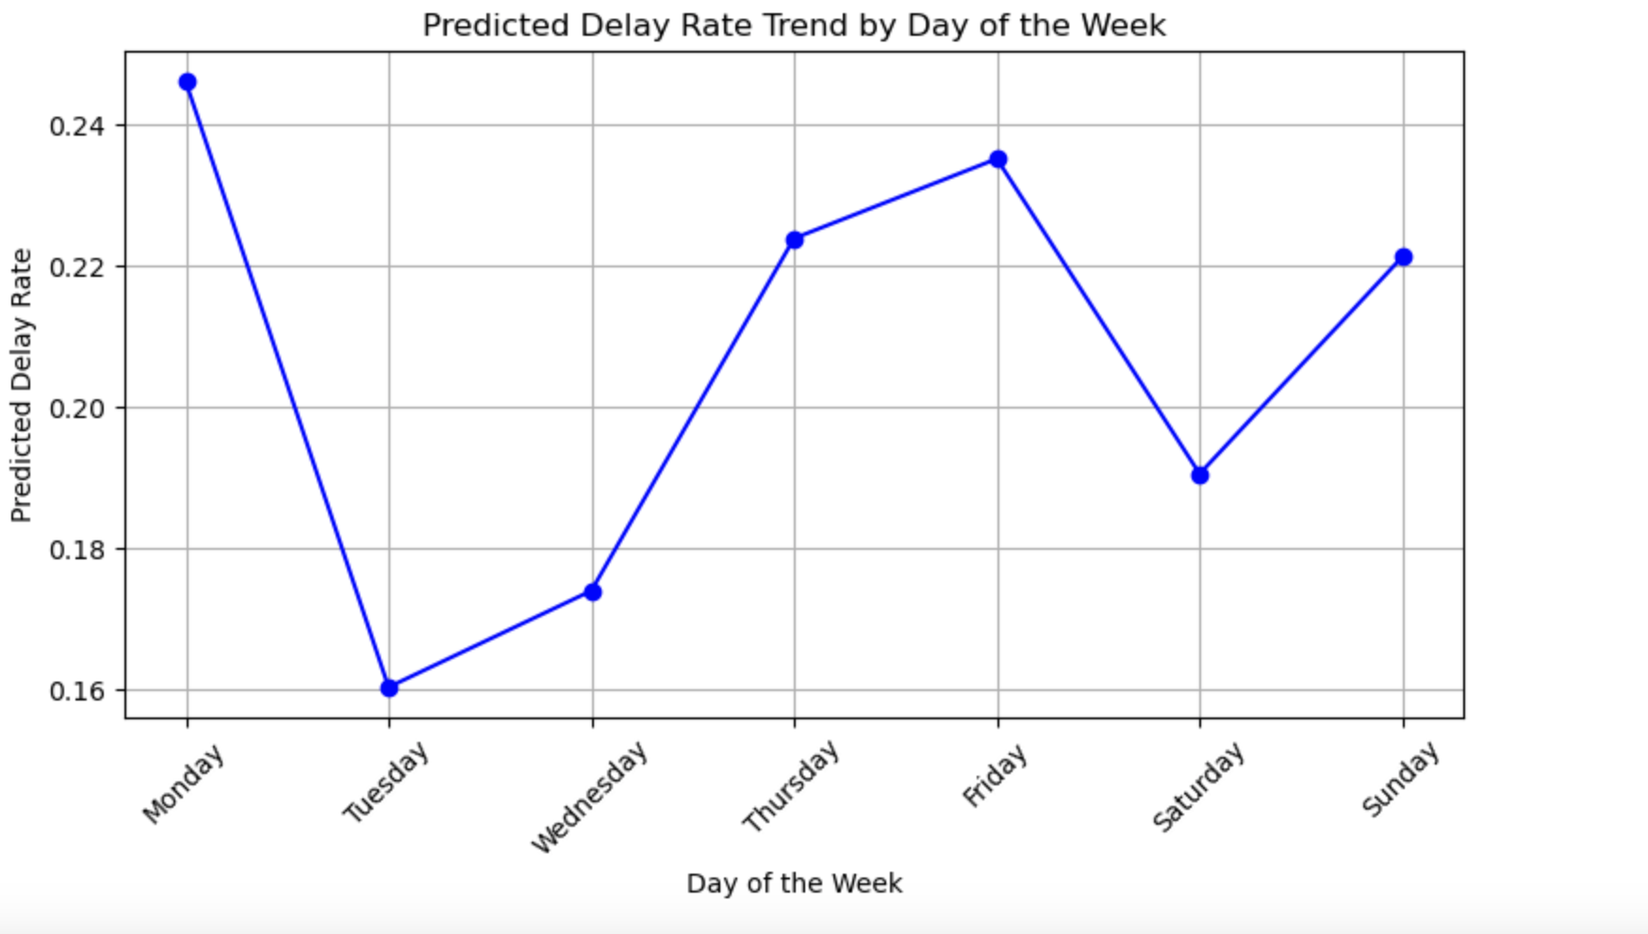
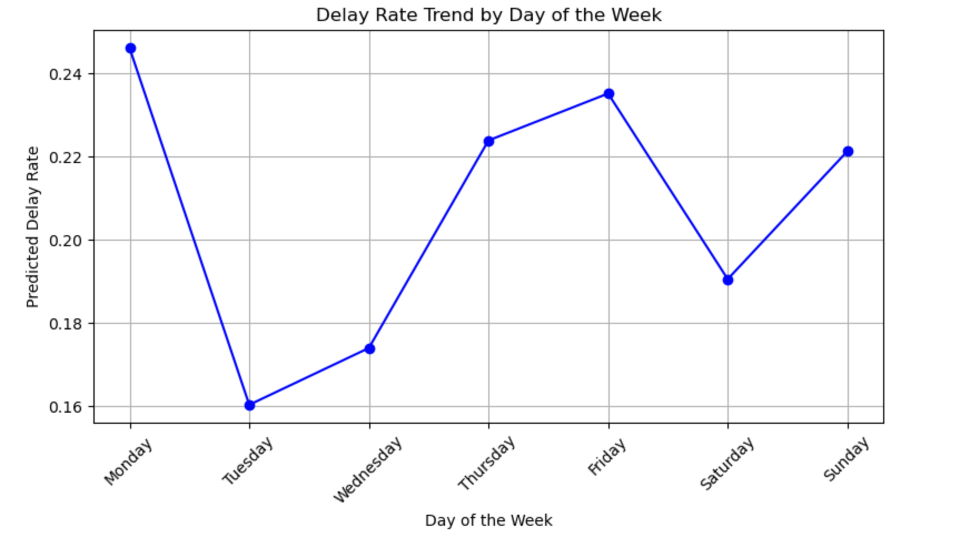
Delay rate by Day of the Week
Historical delay rate
Predicted delay rate
Delay rate(from low to high)
Tuesday
Wednesday
Saturday
Sunday
Thursday
Friday
Monday
Delay rate(from low to high)
Tuesday
Wednesday
Saturday
Sunday
Thursday
Friday
Monday

Slide 11
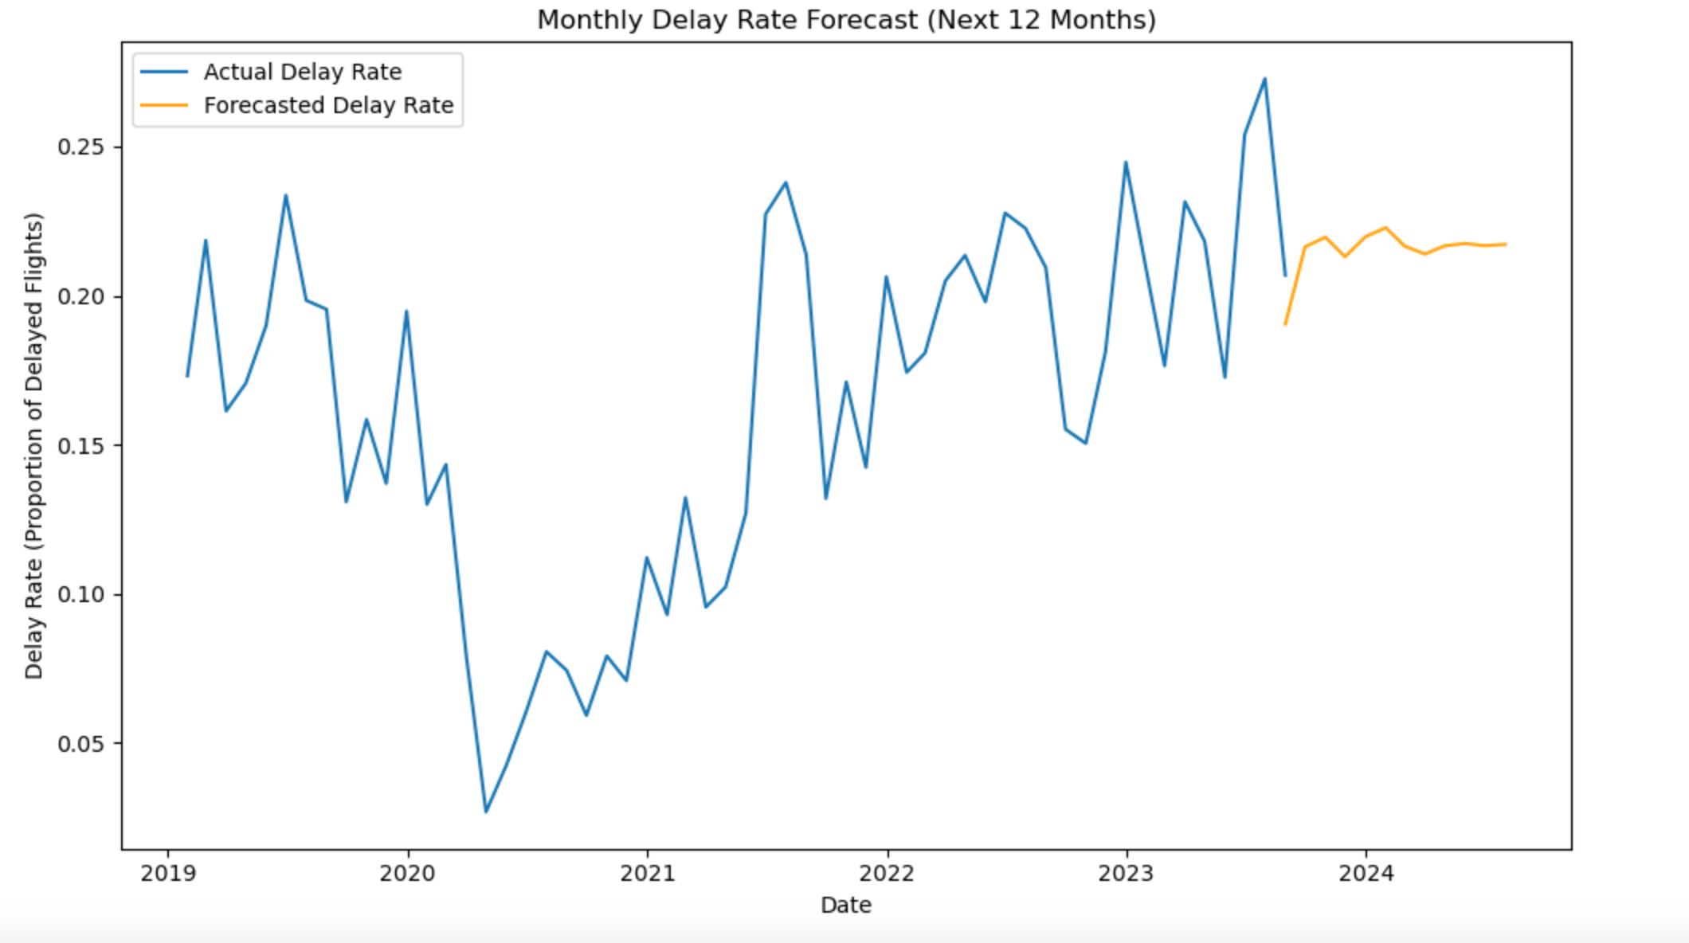
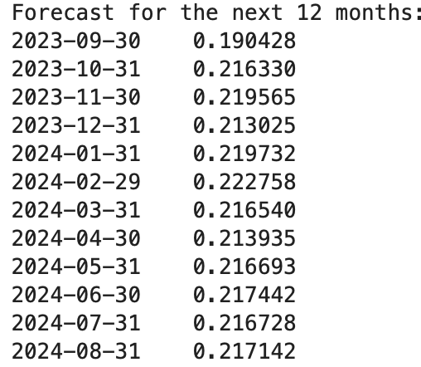
Time Series Analysis to predict Monthly Delay Rate
ARIMA Model

Slide 12
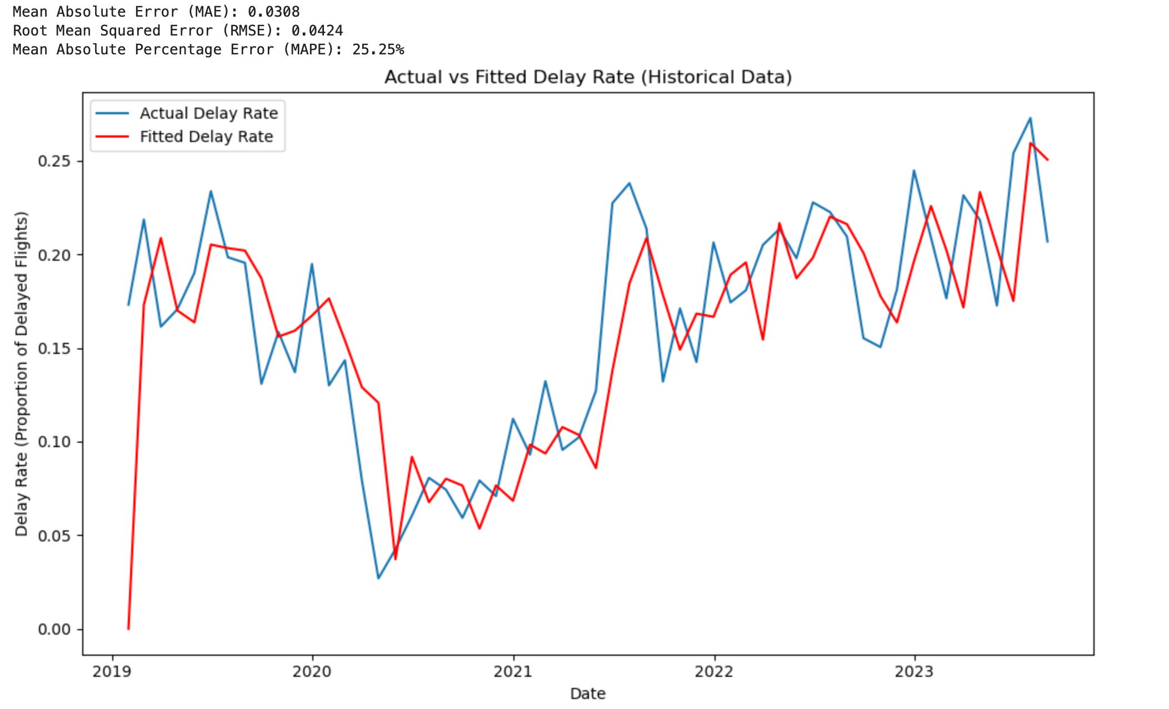
Time Series Model Evaluation
Mean Absolute Error (MAE): 0.0308
Root Mean Squared Error (RMSE): 0.0424
Mean Absolute Percentage Error (MAPE): 25.25%

Slide 13
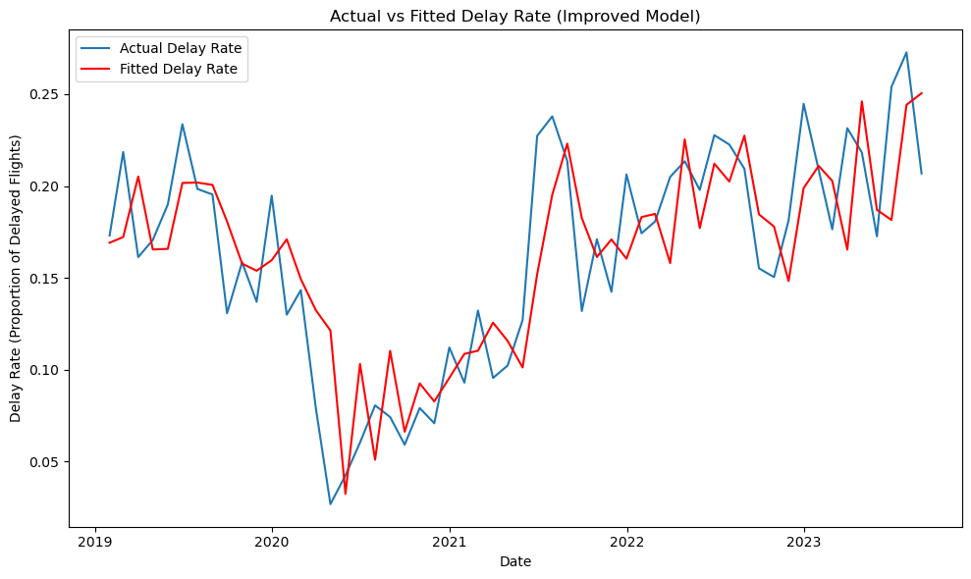
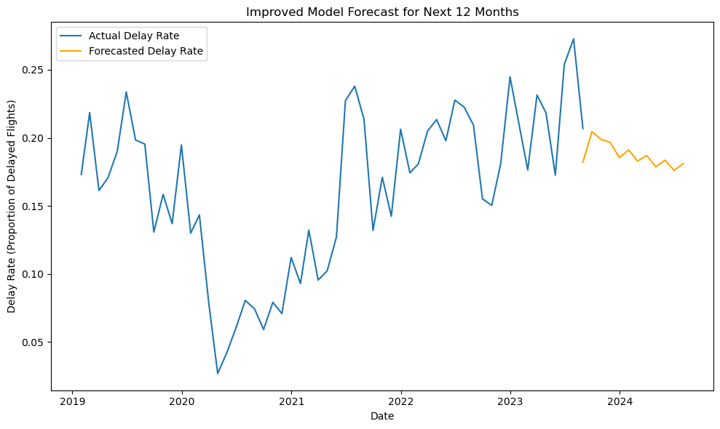
Time Series Model Improvements
Adjust parameters(p, d, q) from grid search
Improved Model - Mean Absolute Error (MAE): 0.0279 Improved Model - Root Mean Squared Error (RMSE): 0.0344 Improved Model - Mean Absolute Percentage Error (MAPE): 24.27%
Improved Time Series Model could be used for predicting delays in future season

Slide 14
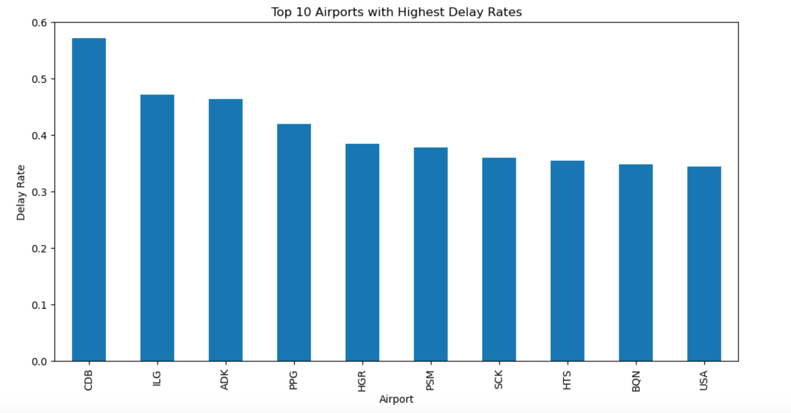
Airports with highest Delay Rates based on historical data
CDB – Cold Bay Airport (Cold Bay, Alaska, USA)
ILG – Wilmington Airport (New Castle, Delaware, USA)
ADK – Adak Airport (Adak Island, Alaska, USA)
PPG – Pago Pago International Airport (Pago Pago, American Samoa)
HGR – Hagerstown Regional Airport (Hagerstown, Maryland, USA)
PSM – Portsmouth International Airport at Pease (Portsmouth, New Hampshire, USA)
SCK – Stockton Metropolitan Airport (Stockton, California, USA)
HTS – Tri-State Airport (Huntington, West Virginia, USA)
BQN – Rafael Hernández International Airport (Aguadilla, Puerto Rico, USA)
USA – Concord-Padgett Regional Airport (Concord, North Carolina, USA)

Slide 15
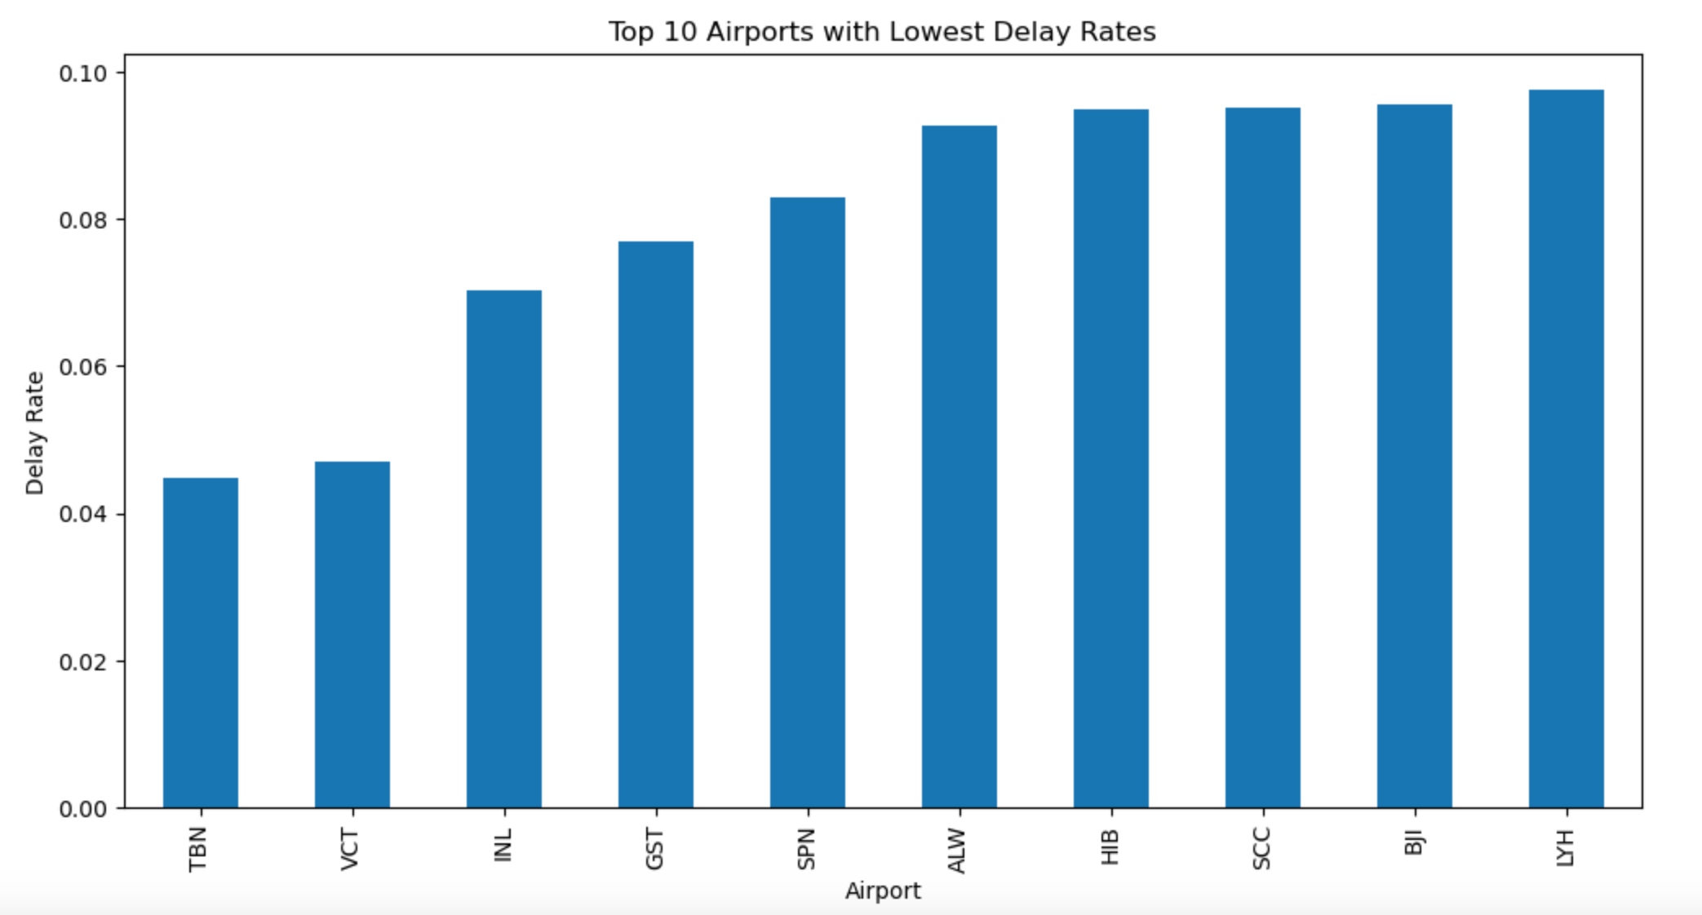
Airports with Lowest Delay Rates based on historical data
TBN – Waynesville-St. Robert Regional Airport (Fort Leonard Wood, Missouri, USA)
VCT – Victoria Regional Airport (Victoria, Texas, USA)
INL – Falls International Airport (International Falls, Minnesota, USA)
GST – Gustavus Airport (Gustavus, Alaska, USA)
SPN – Saipan International Airport (Saipan, Northern Mariana Islands, USA)
ALW – Walla Walla Regional Airport (Walla Walla, Washington, USA)
HIB – Range Regional Airport (Hibbing, Minnesota, USA)
SCC – Deadhorse Airport (Prudhoe Bay, Alaska, USA)
BJI – Bemidji Regional Airport (Bemidji, Minnesota, USA)
LYH – Lynchburg Regional Airport (Lynchburg, Virginia, USA)

Slide 16
Airport Performance based on NAS, Security and Weather
Weather: Airports in regions with severe weather conditions may have higher delays due to weather.
NAS (National Airspace System): Airports with high traffic or airspace congestion may see higher NAS delays.
Security: Airports with stringent or busy security procedures may show higher delays due to security.

Slide 17
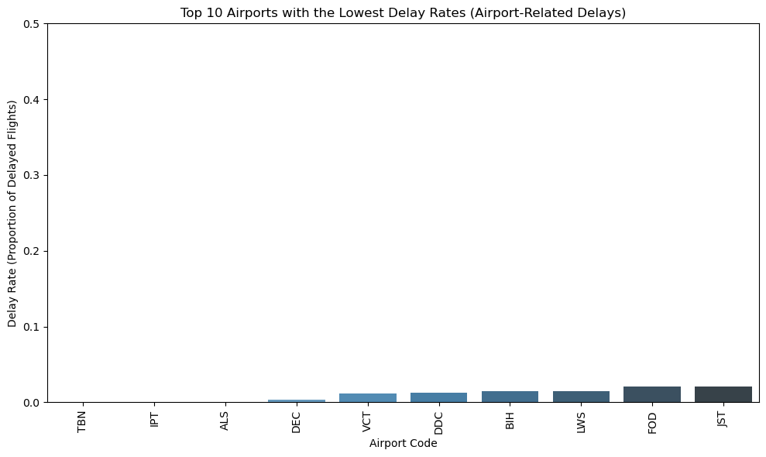
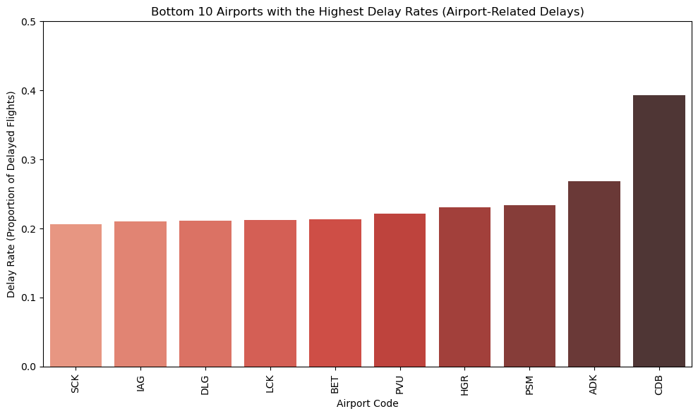
Airport Performance based on NAS, Security and Weather

Slide 18
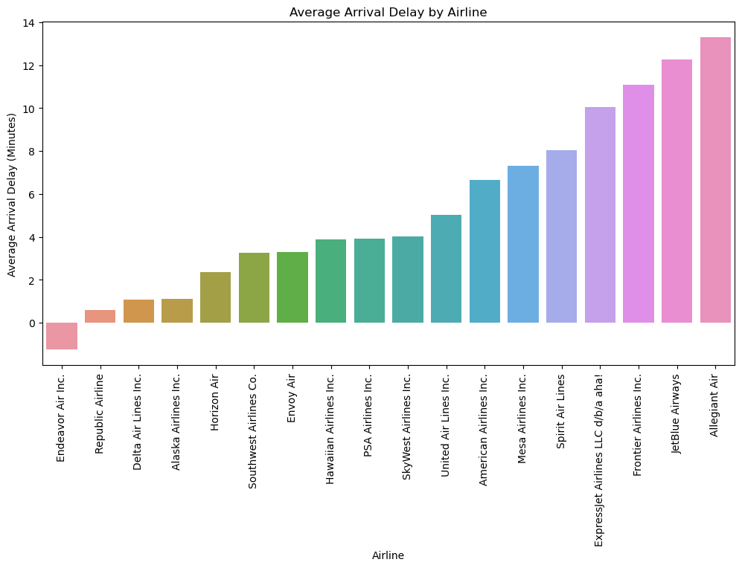
Airlines' Arrival Delays (in Minutes) based on historical data
Endeavor Air Inc. -1.258539
Republic Airline 0.590176
Delta Air Lines Inc. 1.085079
Alaska Airlines Inc. 1.097900
Horizon Air 2.376242
Southwest Airlines Co. 3.269796
Envoy Air 3.278914
Hawaiian Airlines Inc. 3.894757
PSA Airlines Inc. 3.928655
SkyWest Airlines Inc. 4.023311
United Air Lines Inc. 5.035985
American Airlines Inc. 6.661229
Mesa Airlines Inc. 7.309810
Spirit Air Lines 8.029485
ExpressJet Airlines LLC d/b/a aha! 10.031976
Frontier Airlines Inc. 11.100429
JetBlue Airways 12.276125
Allegiant Air 13.284601

Slide 19
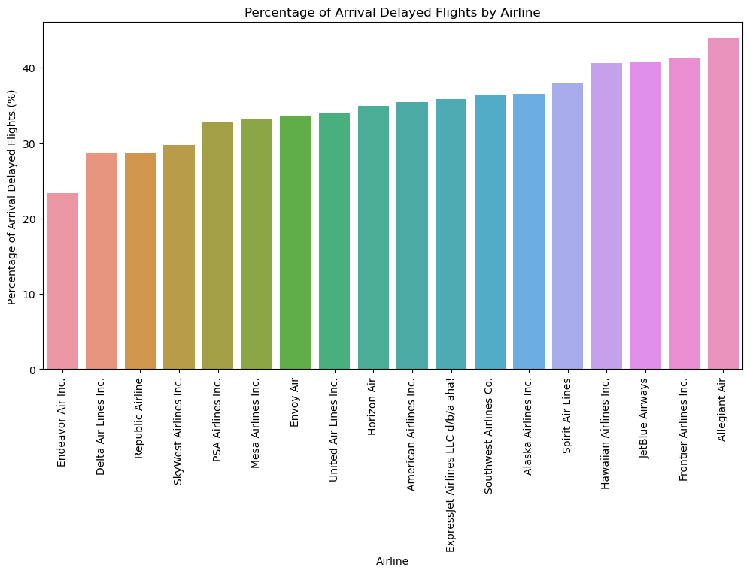
Airlines' Arrival Delays (in %) based on historical data
Endeavor Air Inc. 23.338613
Delta Air Lines Inc. 28.736470
Republic Airline 28.744743
SkyWest Airlines Inc. 29.717660
PSA Airlines Inc. 32.813119
Mesa Airlines Inc. 33.185012
Envoy Air 33.496147
United Air Lines Inc. 34.032304
Horizon Air 34.955774
American Airlines Inc. 35.417733
ExpressJet Airlines LLC d/b/a aha! 35.847585
Southwest Airlines Co. 36.273295
Alaska Airlines Inc. 36.478320
Spirit Air Lines 37.866953
Hawaiian Airlines Inc. 40.646098
JetBlue Airways 40.717425
Frontier Airlines Inc. 41.345219
Allegiant Air 43.839056

Slide 20
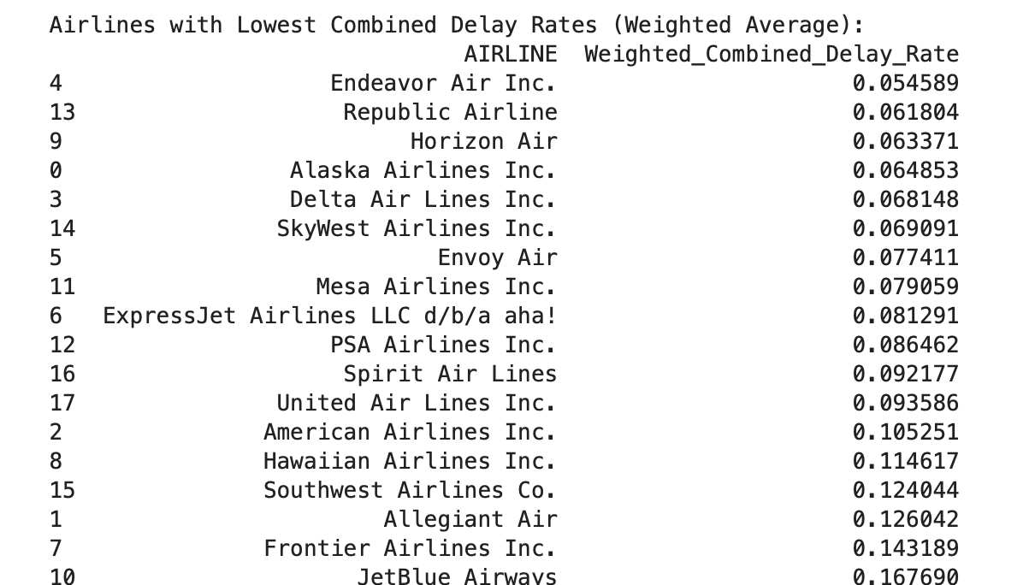
Airline Performance based on Carrier & Late Aircraft delay rate
Carrier Delays: Airlines with operational inefficiencies or maintenance issues may have higher carrier-related delays.
Late Aircraft: Airlines with tightly scheduled flight connections or operational delays may show higher late aircraft delays.
Weighted average delay rate (0.6 for Carrier and 0.4 for Late Aircraft)

Slide 21
Tips To Avoid Flight Delays
Airlines
Endeavor Air Inc. & Republic Airlines performed well with low delayed rate and time
Allegiant Air, JetBlue Airways and Frontier Airlines are airlines we should avoid
Airport
Choose Airport based on customers' need
Avoid Airport with higher delayed rate when possible
Month
June, July and December are peak season with higher delayed rate
September, October, November are seasons with lower delayed rate
Predict future monthly delayed rate with Time series Model
Date
Tuesday, Wednesday have lower delayed rate while Monday, Friday delayed rate are high

Slide 22
FLIGHT Cancellations

Slide 23
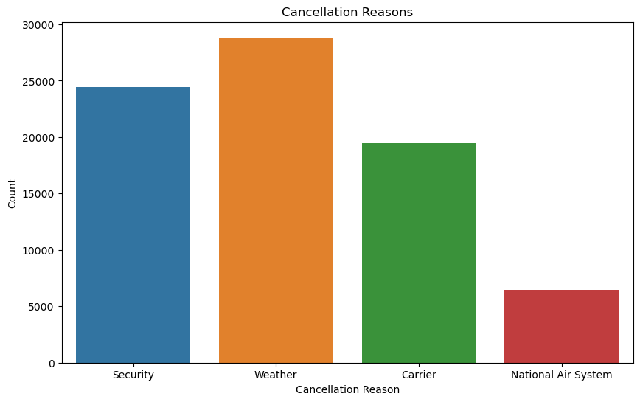
Causes of Cancellations
Cancelled flight rate: 2.64%
Diverted flight rate: 0.24%
Cancellation Reasons with Counts and Percentages:
Weather: 28772 incidents (36.36%)
Security: 24417 incidents (30.85%)
Carrier: 19476 incidents (24.61%)
National Air System: 6475 incidents (8.18%)

Slide 24
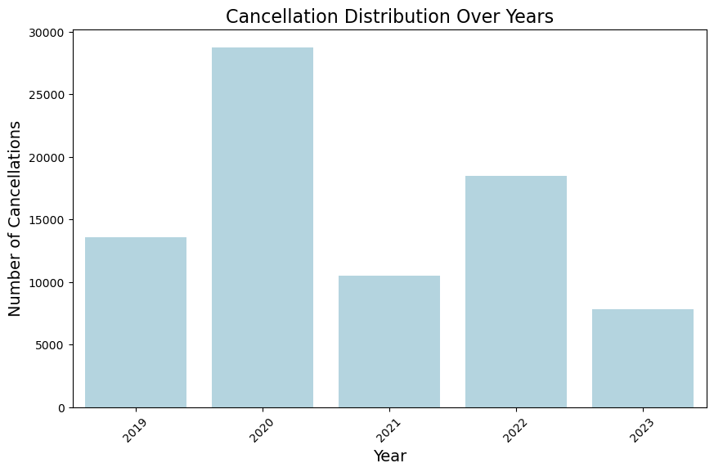
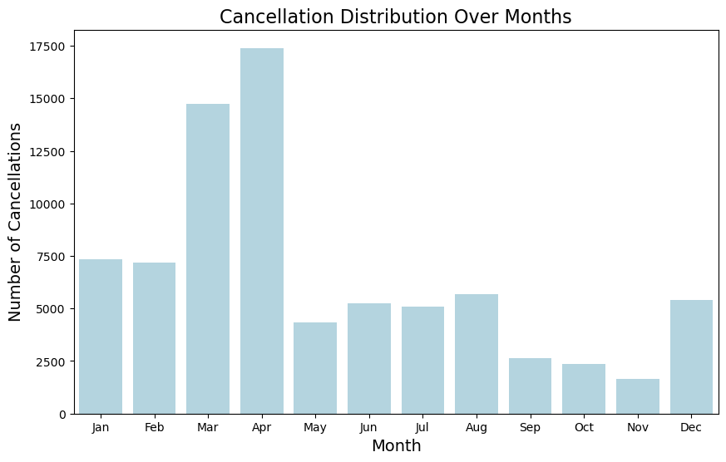
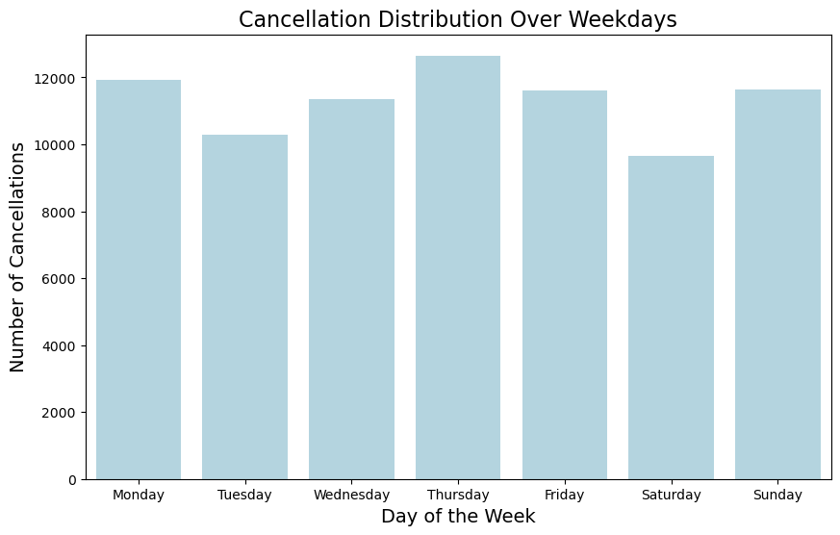
Cancellation Patterns - Time Periods

Slide 25
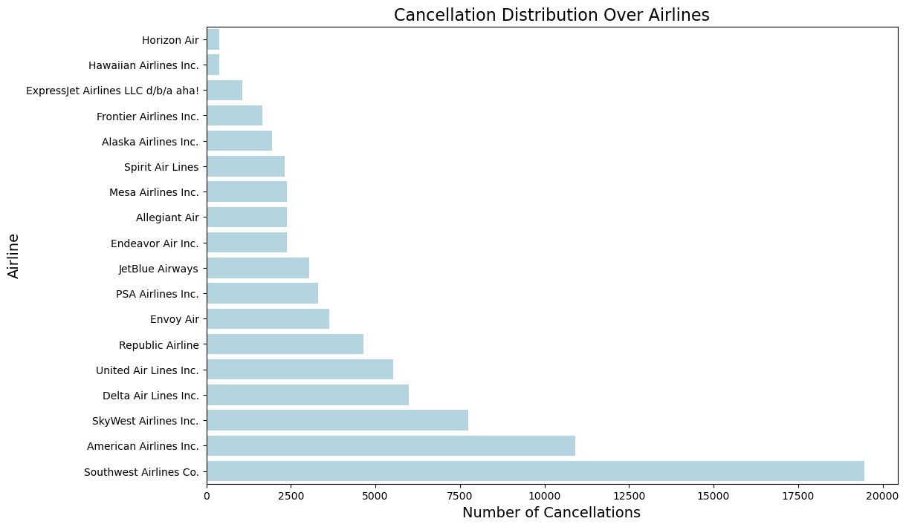
Cancellation Patterns - Airlines
Horizon Air 374
Hawaiian Airlines Inc. 388
ExpressJet Airlines LLC d/b/a aha! 1062
Frontier Airlines Inc. 1666
Alaska Airlines Inc. 1934
Spirit Air Lines 2312
Mesa Airlines Inc. 2373
Allegiant Air 2383
Endeavor Air Inc. 2394
JetBlue Airways 3039
PSA Airlines Inc. 3301
Envoy Air 3633
Republic Airline 4646
United Air Lines Inc. 5536
Delta Air Lines Inc. 5982
SkyWest Airlines Inc. 7745
American Airlines Inc. 10907
Southwest Airlines Co. 19465

Slide 26
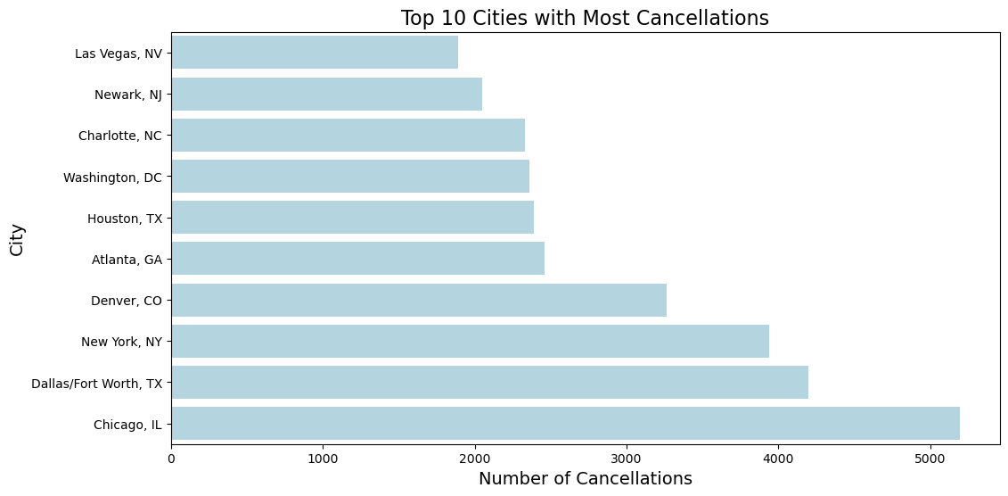
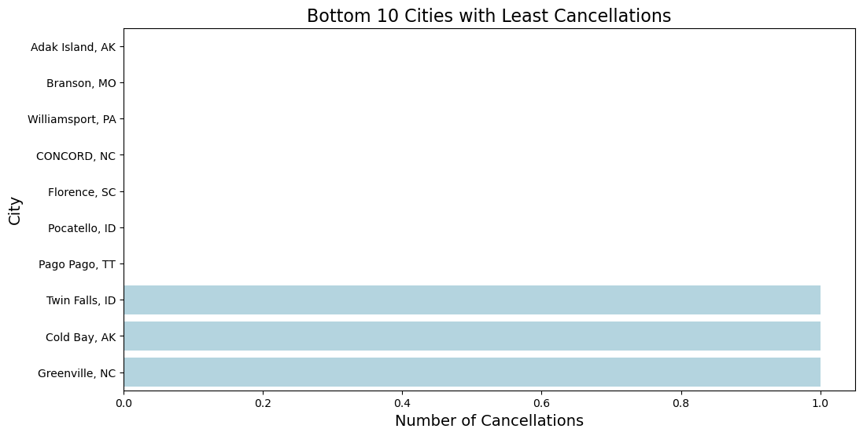
Cancellation Patterns - Airports

Slide 27
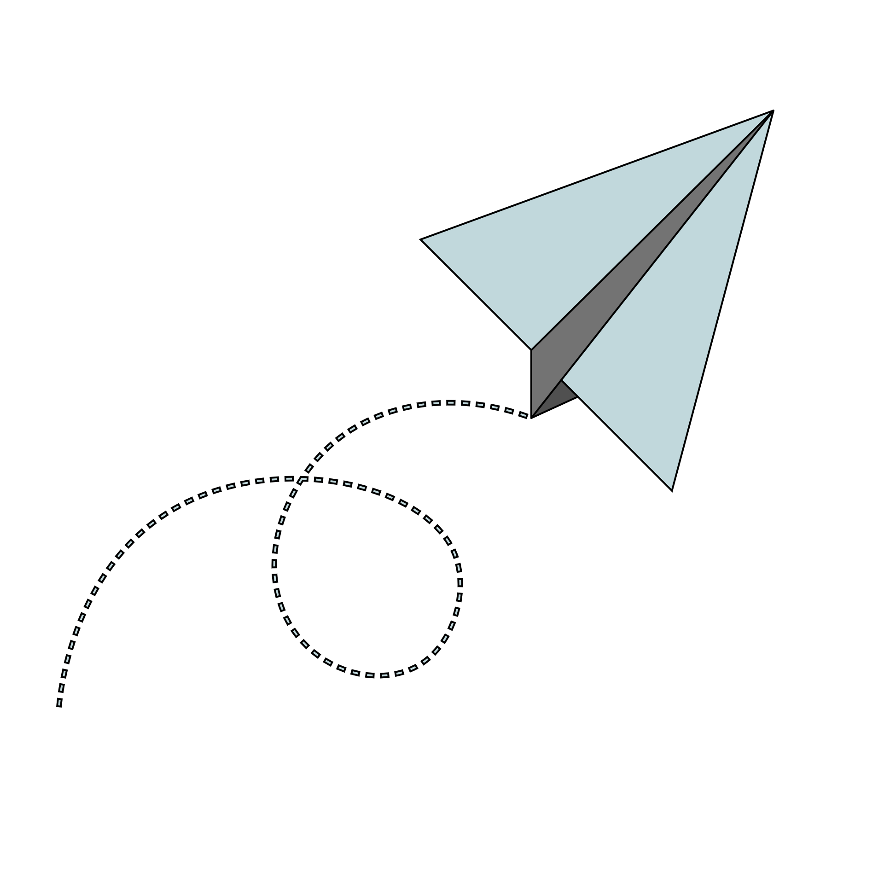
Cancellation Prediction Model
Random Forest
Input: Airlines, Origin Airport, Destination Airport, Day of the week, Month, Year, Scheduled Departure/Arrival time
Predict if the flight will be cancelled

Slide 28
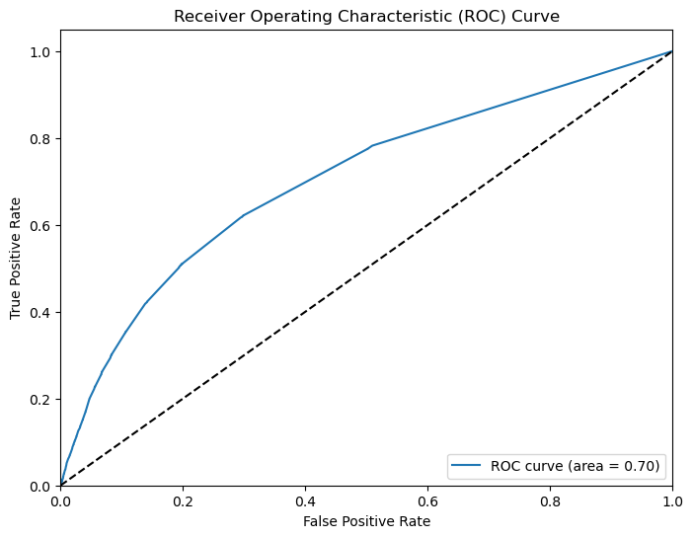
Cancellation Prediction Model Evaluation
Accuracy 0.97, AUC 0.70
The model has some predictive power
Only Post-Covid data to avoid skewness
Confusion Matrix: [120520 234]
[ 2553 19]
Data Limitation (Weather, Airline, NAS)
Check the Dashboard for live predictions

Slide 29
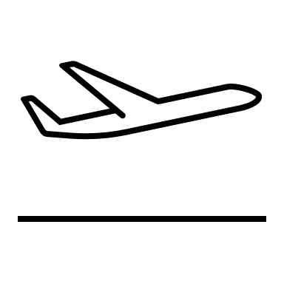
Tips to Avoid Flight Cancellations
Airlines
Horizon Air Inc. & Hawaiian Airlines performed well with low cancellation rate
Southwest Air and American Airlines are airlines we should avoid
Airport
Chicago, Dallas and New York are the most unpredictable
Quiet cities don’t see much cancellations
Month
March and April experience most cancellation
Then Dec to Feb season
Date
No clear differences
Saturdays are slightly better and Thursdays are slightly worse

Slide 30
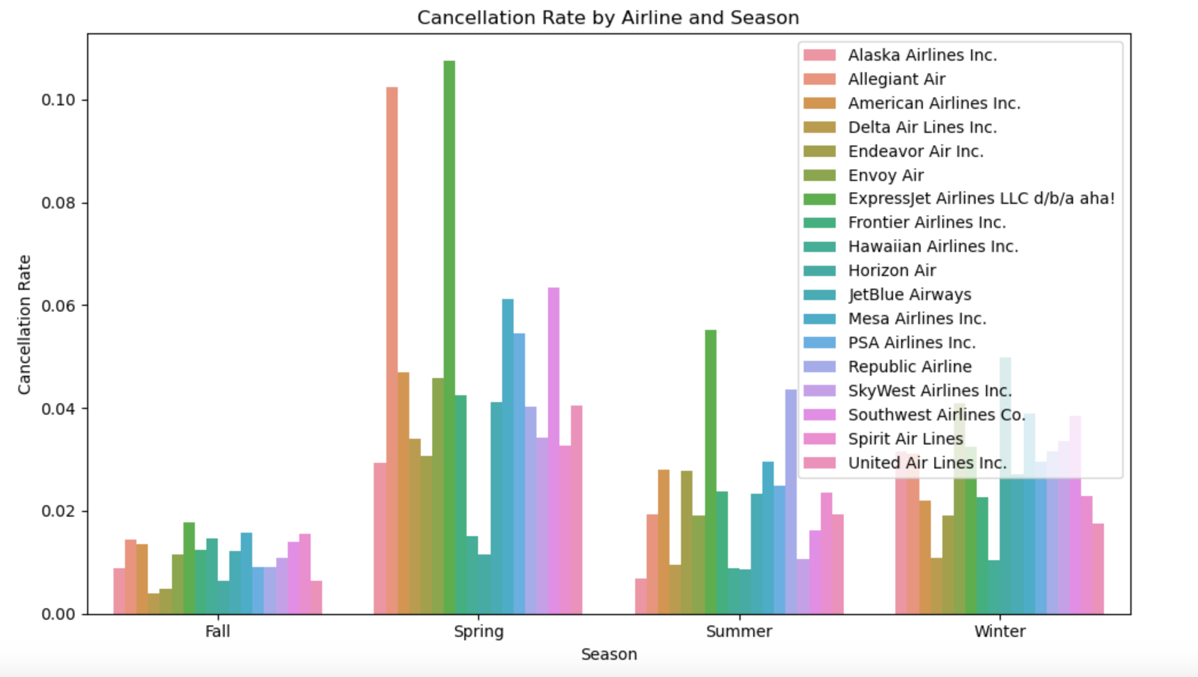
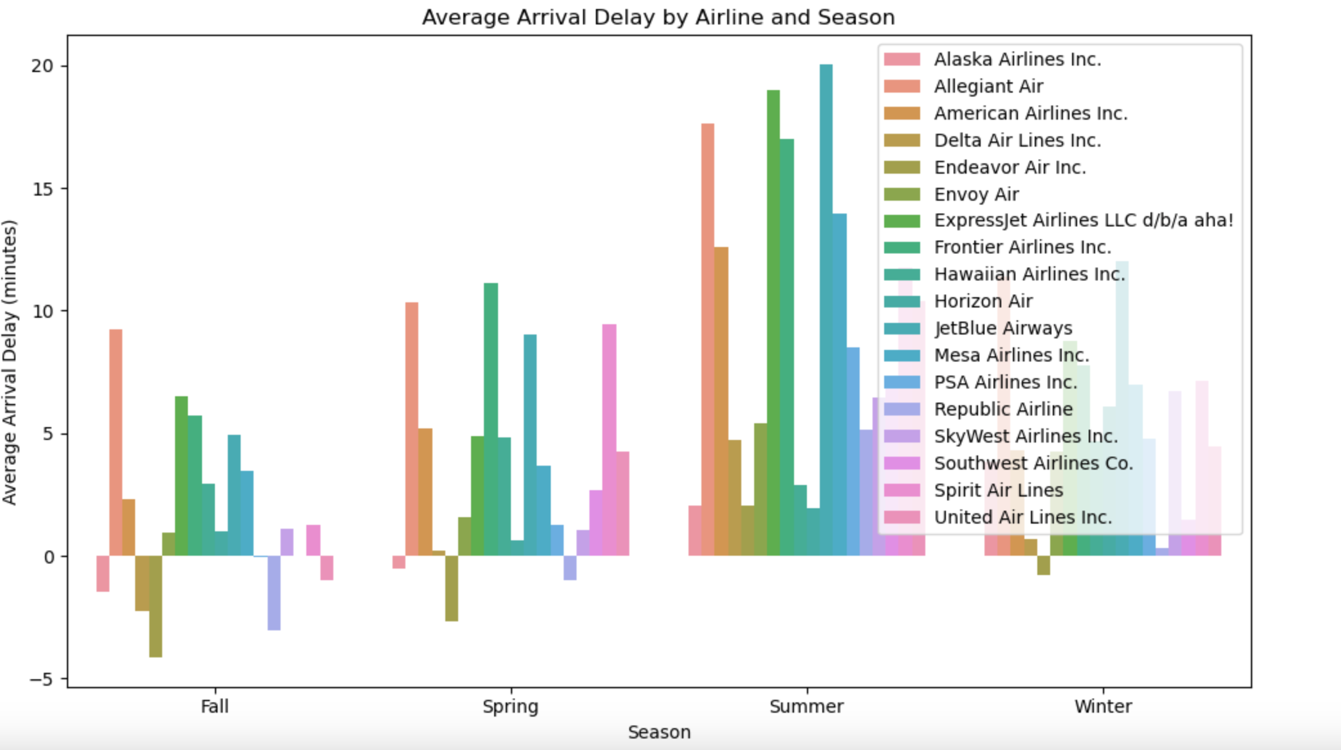
Which Airline should we choose for the Winter Promotion Program?
Airlines Performance by Season

Slide 31
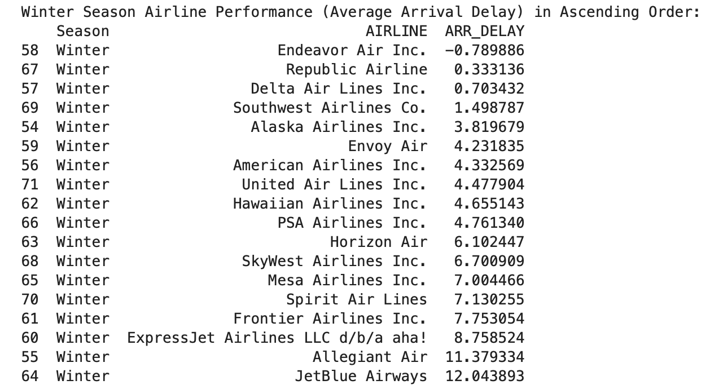
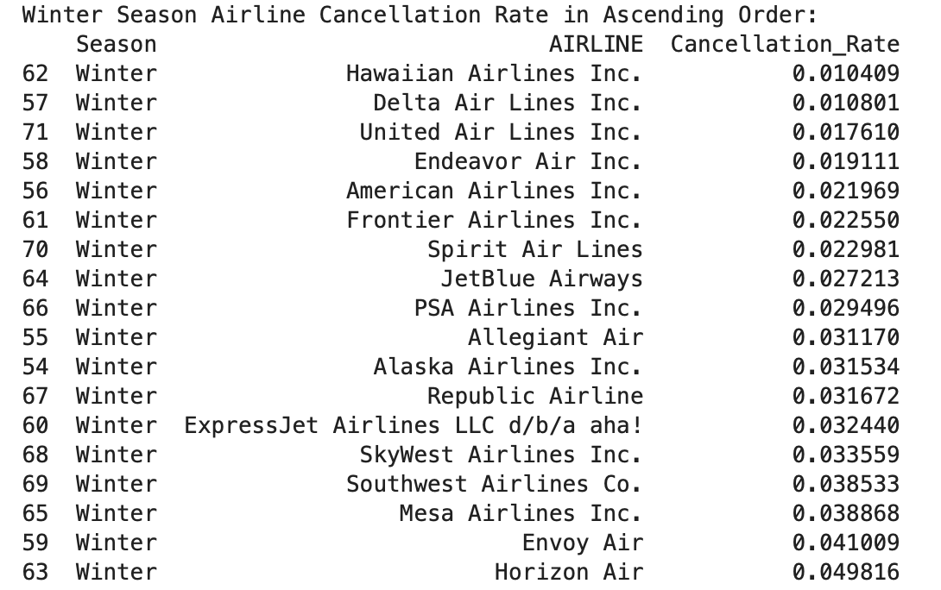
Targeted Airlines for Winter Promotion
Endeavor Air Inc.
Delta Air Lines Inc.

Slide 32
Future improvements of model
Use Feature Engineering: Add new features and interactions.
Collect More External Data: Integrate weather, traffic, and holidays.
Error Analysis: Adjust threshold to balance precision/recall.
Regularization: Prevent overfitting with tree depth or feature limits.
Use Advanced ML Models and Techniques: Use techniques like Hyperparameter Tuning, Class Imbalance, Model Interpretability

Slide 33
Thank You For Listening
Team Gordon

Slide 34
Technical Appendix

Slide 35
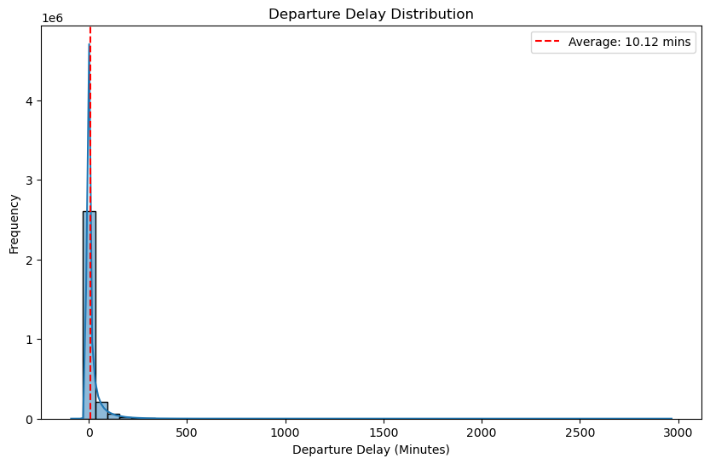
How many flights experience Departure Delays?
Percentage of flights with departure delays: 33.97%
Average Departure Delay: 10.12 minutes
Range of Departure Delays: -90.0 minutes to 2966.0 minutes

Slide 36
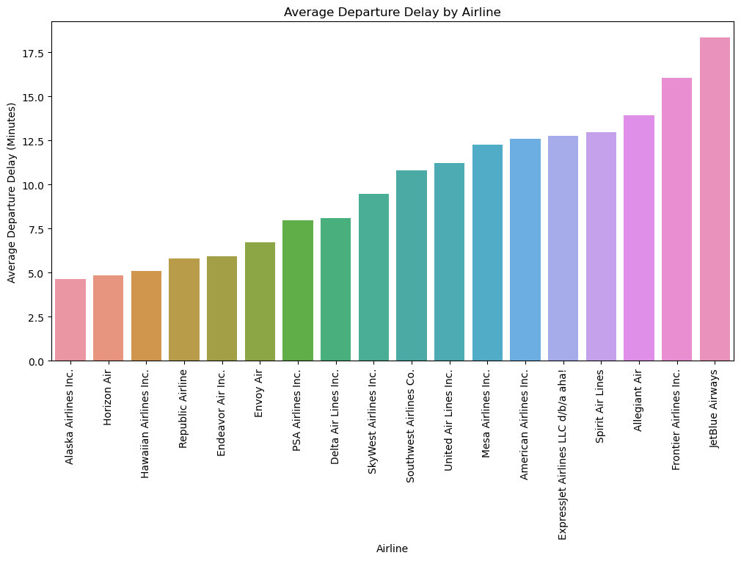
Which Airlines experience Departure Delays the most (in Minutes)?
Airlines | Avg. Delay (Minutes)
Alaska Airlines Inc. | 4.640018
Horizon Air | 4.832775
Hawaiian Airlines Inc. | 5.089537
Republic Airline | 5.804359
Endeavor Air Inc. | 5.951135
Envoy Air | 6.728256
PSA Airlines Inc. | 7.972124
Delta Air Lines Inc. | 8.106748
SkyWest Airlines Inc. | 9.458294
Southwest Airlines Co. | 10.816957
United Air Lines Inc. | 11.217032
Mesa Airlines Inc. | 12.277383
American Airlines Inc. | 12.609895
ExpressJet Airlines LLC | 12.774462
Spirit Air Lines | 12.981880
Allegiant Air | 13.907797
Frontier Airlines Inc. | 16.033574
JetBlue Airways | 18.322555

Slide 37
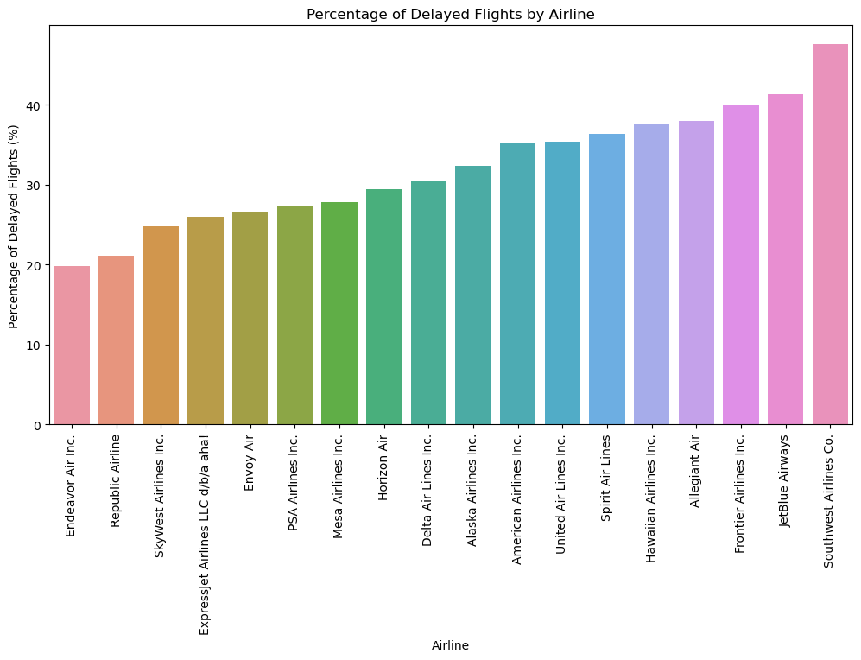
Which Airlines experience Departure Delays the most (in %)?
Endeavor Air Inc. 19.802978
Republic Airline 21.092843
SkyWest Airlines Inc. 24.789902
ExpressJet Airlines LLC d/b/a aha! 25.976259
Envoy Air 26.659760
PSA Airlines Inc. 27.411559
Mesa Airlines Inc. 27.822799
Horizon Air 29.441925
Delta Air Lines Inc. 30.440054
Alaska Airlines Inc. 32.403464
American Airlines Inc. 35.304921
United Air Lines Inc. 35.351670
Spirit Air Lines 36.395064
Hawaiian Airlines Inc. 37.661519
Allegiant Air 37.971291
Frontier Airlines Inc. 39.959584
JetBlue Airways 41.360732
Southwest Airlines Co. 47.540230

